Slide 1

AI for better Business
Led by
Paulson Grigarichan

Slide 2
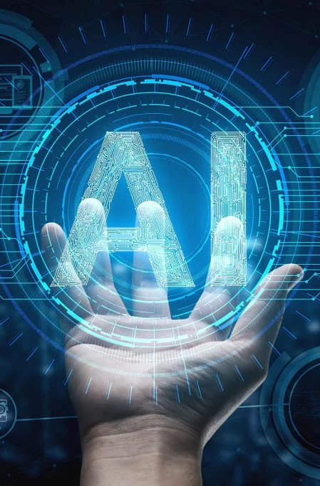
AI For Better Business
Efficiency and Productivity gains
Better Customer Service
New Capabilities and business model expansion
Improved speed of business
Improved Monitoring
Better quality and reduction of Human Error
Better Talent Management

Slide 3

AI in customer service
5 Ways to Use AI to Improve Your Customer services
Chatbot
Language Analysis
Object Detection
Optical Character Recognition
Machine learning models

Slide 4
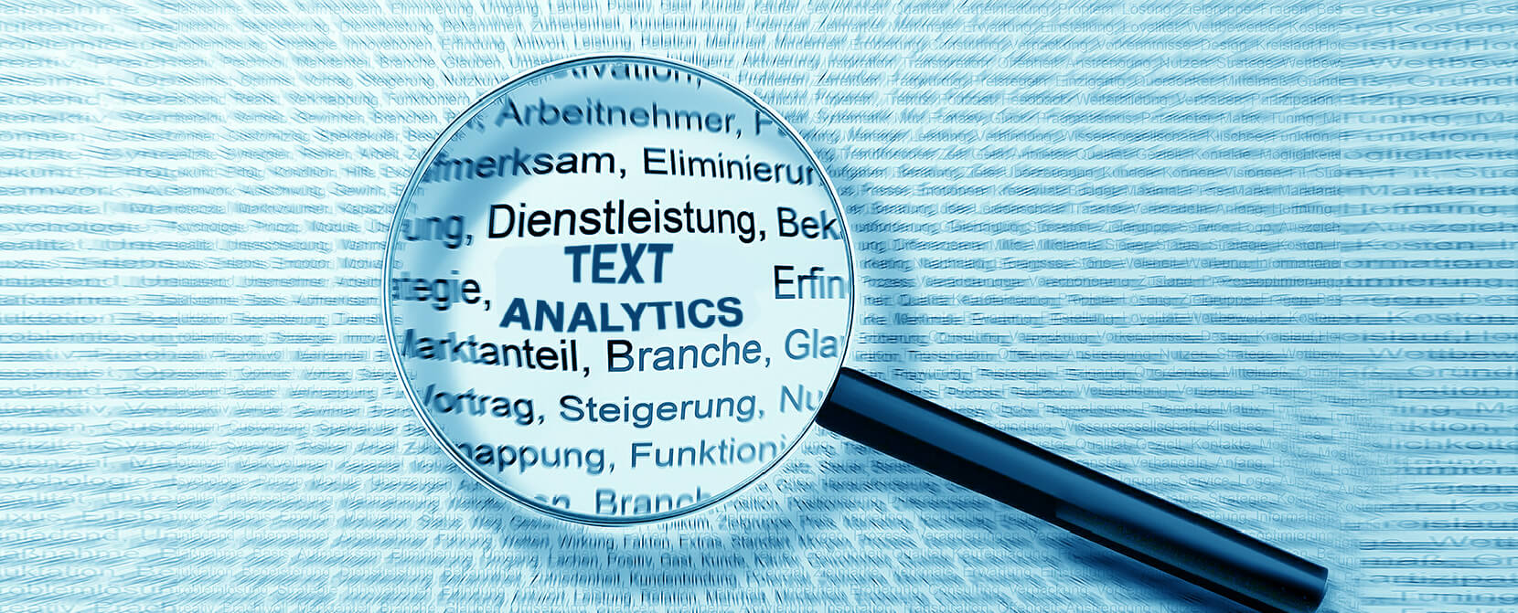
Text Analytics
It is an automation Process
Understanding negative and positive customer experience
Extracting meaning out of text

Slide 5
Text Analytics Framework
Possible Data Collection
Language Identification
Part of speech tagging
Sentiment Analysis
Named entity recognition
Event extraction
Text Classification
Text Categorization
Term Frequency
Topic Modelling

Slide 6
Text Analytics in Customer services
Using text analytics is a great way to look at open-text responses in a way that is both quick and scalable
Analysing customer-related data allows organizations to better understand customers’ problems
Text Analytics with Probabilistic Topic Modelling using the Latent Dirichlet Allocation (LDA) Algorithm

Slide 7
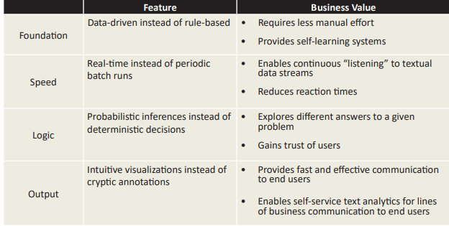
Features of the Latest Text Analytics Solutions

Slide 8
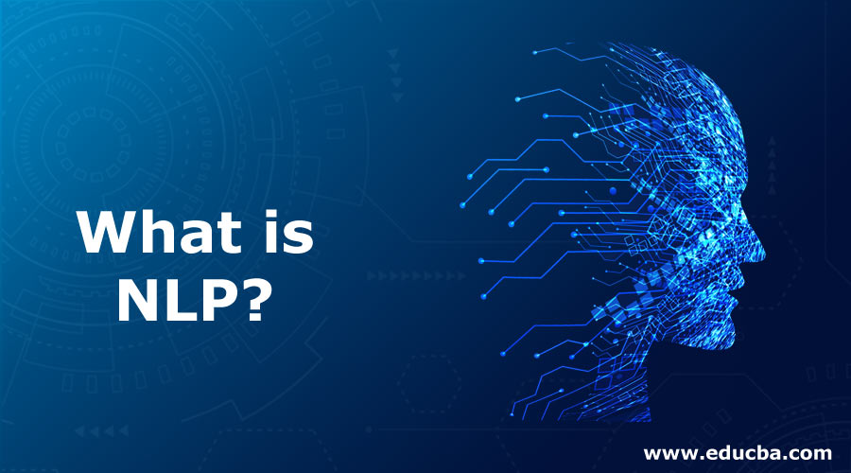
Natural Language Processing
Natural language processing (NLP) is a branch of machine learning and artificial intelligence that focuses on deriving meaning from human language and automatically handling it.
NLP has various use cases in our modern society, including chat-bots, sentiment analysis from customer reviews, and identifying fake news.

Slide 9
NLP Framework
Some NLP Framework
Various Concepts of NLP
PyTorch
SpaCy
Scikit-Learn
Keras
Tokenization
Stop Word Removal
Stemming
Lemmatization
Regular Expression
Sentiment Analysis

Slide 10

NLP in Business
Sentiment Analysis
Email Filters
Voice Recognition
Information Extraction

Slide 11
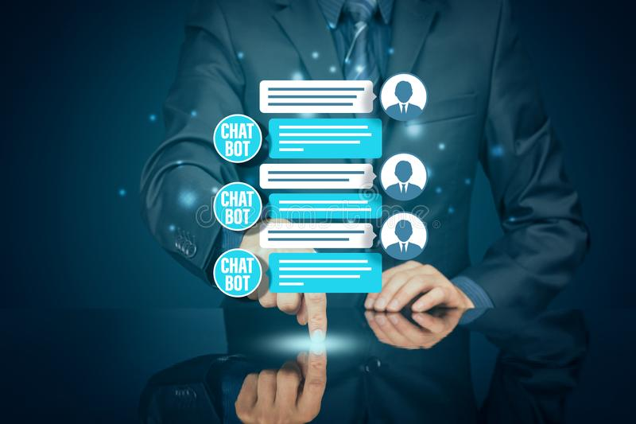
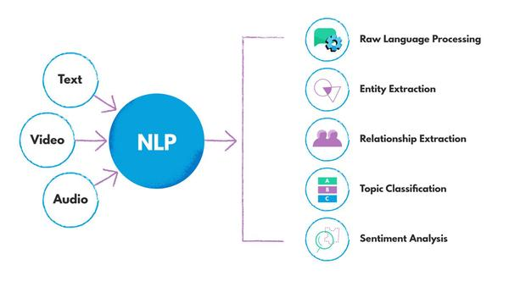
Goal of NLP
Computers to achieve human-like comprehension of texts/languages.

Slide 12
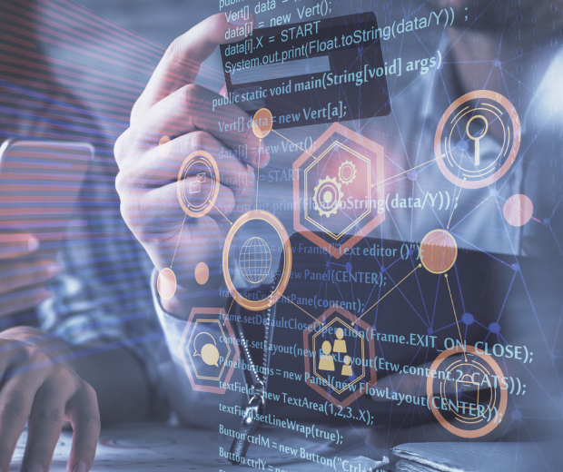
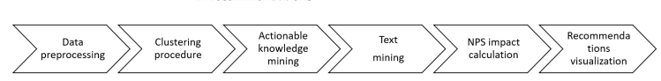
NLP based Recommender System
Knowledge Discovery Techniques
Sentiment Mining Techniques
Data Visualizations Techniques
Sentiment Analysis Based Customer Loyalty Improvement

Slide 13
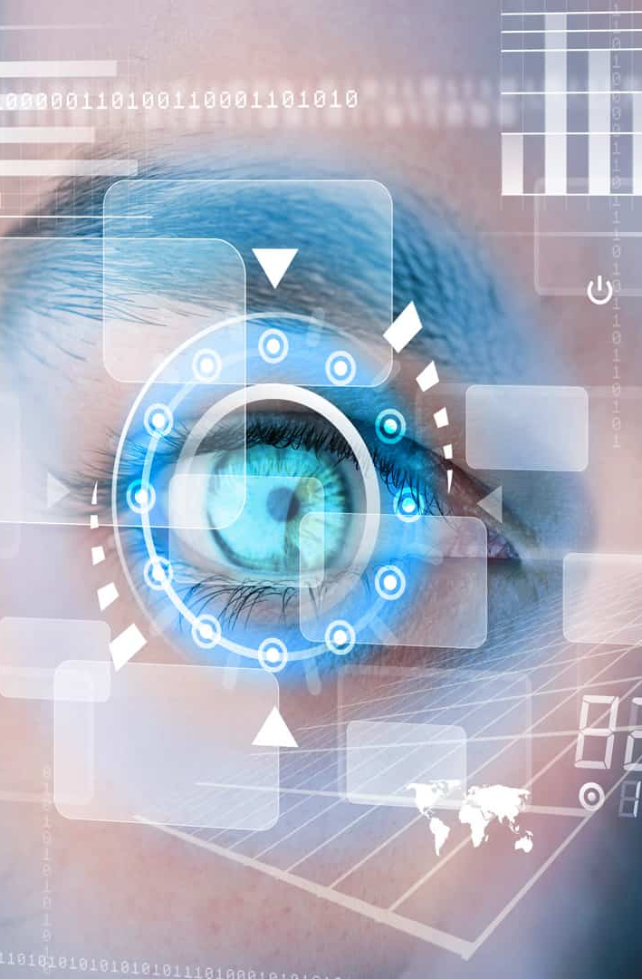
Computer Vision
Facial expression Recognition
Pattern Recognition
Feature Categorizing
Object tracking
Establishing effective computer vision with electronic systems and deep neural networks

Slide 14
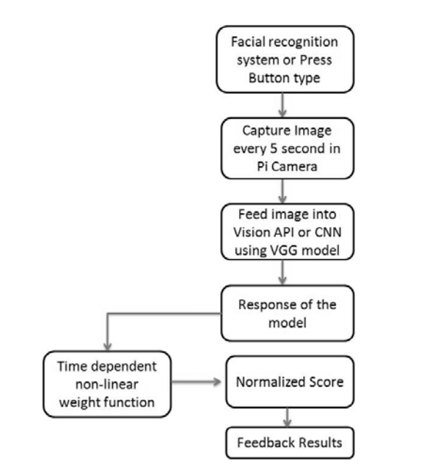
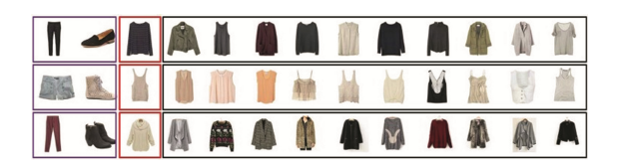
Enhancing Online Customer Service with CV
Facial Expression Detection using CNN, Google Vision API and OpenCV
Online Customer Shopping Experience with CV and ML methods
Extract Semantic Attributes from Images
Enrich Recommendation System with Image Features

Slide 15
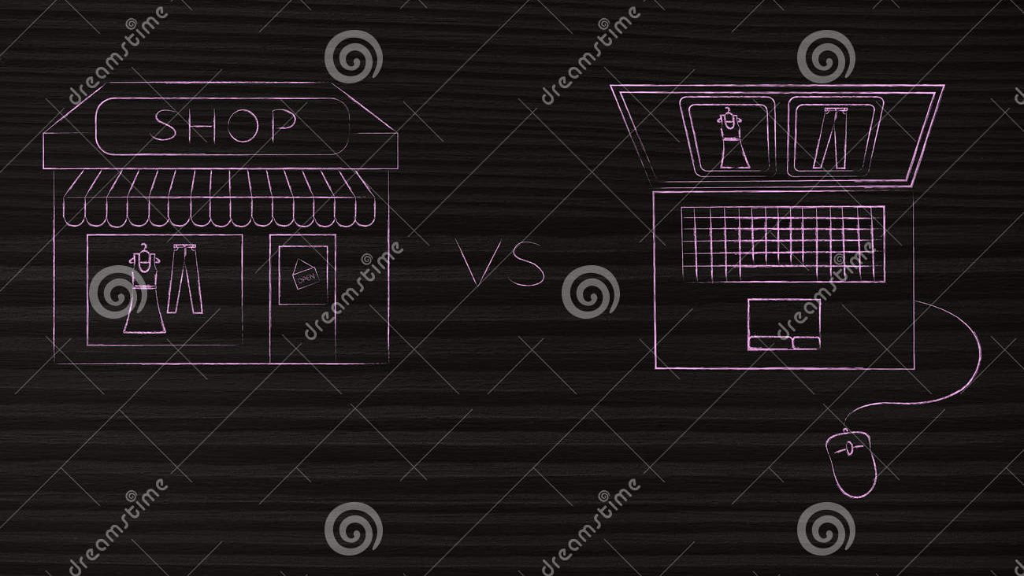
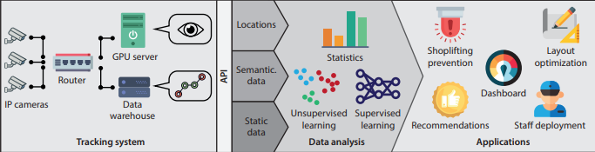
Better view on customers with Computer Vision
Data acquisition viability in offline retail setting.
Visual Acquisition system to acquire real-time movements
Using ML methods to narrow gap between online and offline retail.

Slide 16

Literature Review Evaluation
Today’s advanced text analytics techniques are domain free
To address traditional manual data analytics , automated text mining
Combining NLP, vectorization and classification algorithms for future.
The Intelligent NLP based Customer Service System depicts the application of NLP for general purpose use of business sectors.
Enhancing customer experience with Face expression recognition is a hot research area that need more work to do.

Slide 17


Research Gap
Still existence of cryptic code in text analytics solutions Image data contains lot of noisy data which in turn decreases the performance of AI implements Ignorance of some colour , appearance and texture of Computer Vision based recognitions
Advancing newly aligned graph based visual depictions Researchers might need to carefully test the performance of framework before real use New models to extract human understandable visual attributes should be utilized

Slide 18

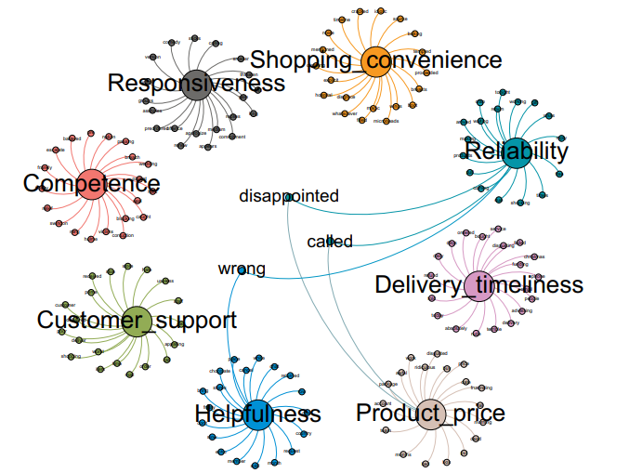
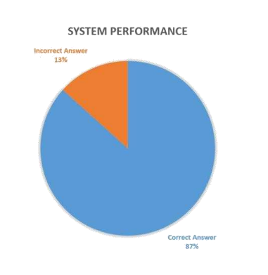
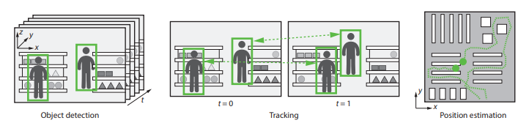
Results
Topic Network for Sentiments
NLP based Chat Bot
Object Detection from video

Slide 19

Conclusion and Future Aspects
Application of Text analytics, NLP and Computer Vision in the field of business enhances it to a hight extent
Even though the focus of our research was to mostly focused on customer service, the AI methods might work wonders with other areas of business concerns.
However, keeping the positive impact aside, finding a state of art method to handle the noisy data might improve performance of AI methods in business platforms to its peak
Additionally moving to 100 percent automated text analytics, NLP and CV might be the booming business aspects in near future.

Slide 20

Thank you

